Slide 1
Localization of Transmitter using TDOA analysis Mid Term Report
Supervisor – Prof. Seshan Srirangarajan
By -
Divyansh Kumar and Gopal Saha

Slide 2
Why Localize Transmitter ?
Defence – Tracking enemy radars and drones
UAV Tracking - Detects unauthorized or enemy UAVs by pinpointing their source location
Mobile Terminal Positioning - Provides accurate position for mobile users even in environments where traditional GPS is unreliable
Medical Tracking - Localizing transmitter-equipped medical devices to track patients and belongings

Slide 3
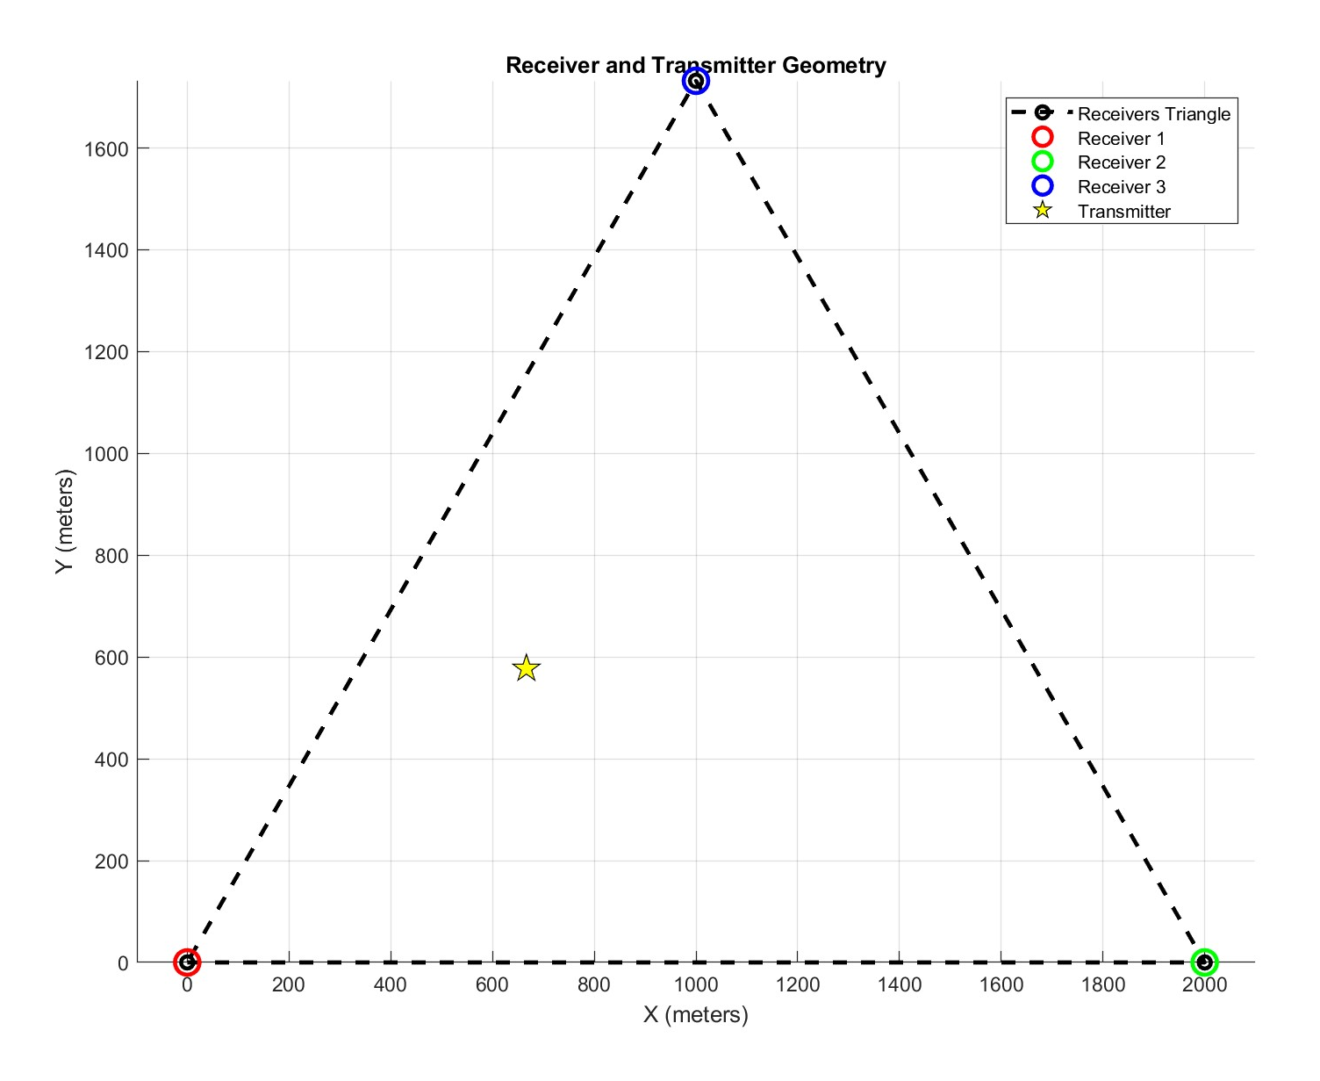

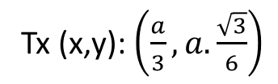
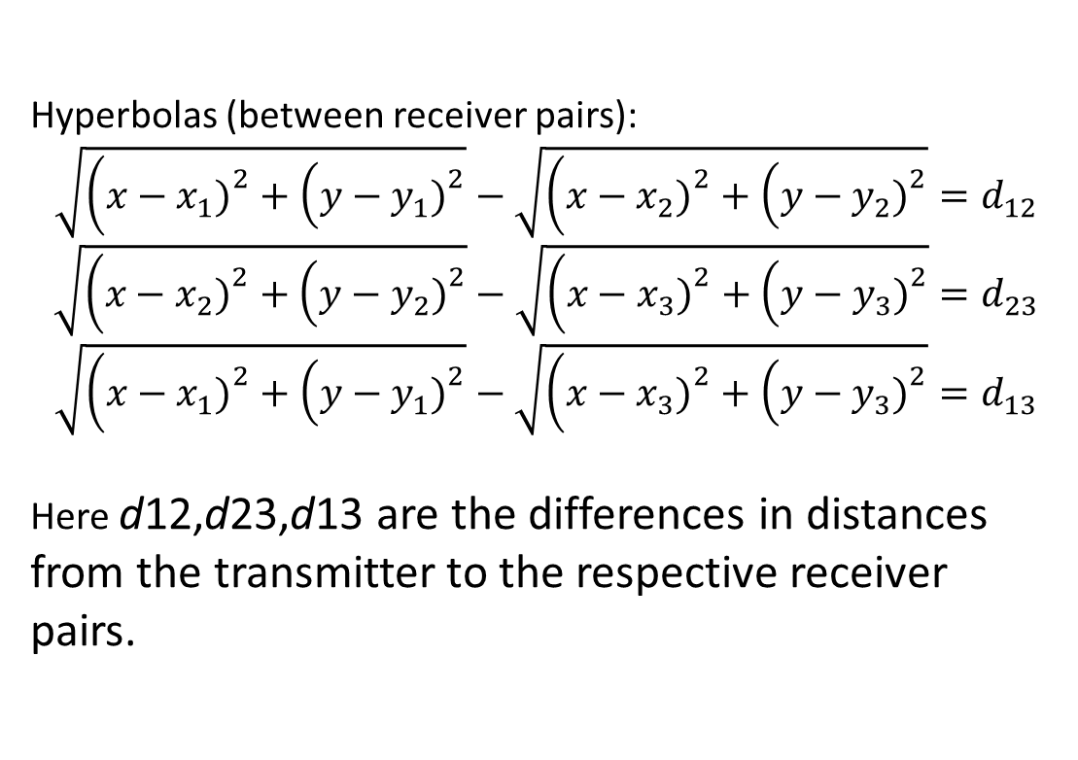
What is TDOA ?
TDOA stands for Time Difference Of Arrival. Its one of the methods to pinpoint transmitter location
Hyperbolic Multilateration : Each pair of receiver defines a hyperbola in 2D (hyperboloid in 3D). [1]
For example Lets take 3 receivers forming a triangle and 1 transmitter in 2D plane. Coordinates of R1,R2,R3 are (0,0), (a,0), ($\frac{a}{2},a.\frac{\sqrt{3}}{2})$
Hyperbolas (between receiver pairs):
$$\sqrt{\left(x−x_{1}{\left.)\right.}^{2}+\left(y−y_{1}{\left.)\right.}^{2}\right.\right.}−\sqrt{\left(x−x_{2}{\left.)\right.}^{2}+\left(y−y_{2}{\left.)\right.}^{2}\right.\right.}=d_{12}$$
$$\sqrt{\left(x−x_{2}{\left.)\right.}^{2}+\left(y−y_{2}{\left.)\right.}^{2}\right.\right.}−\sqrt{\left(x−x_{3}{\left.)\right.}^{2}+\left(y−y_{3}{\left.)\right.}^{2}\right.\right.}=d_{23}$$
$$\sqrt{\left(x−x_{1}{\left.)\right.}^{2}+\left(y−y_{1}{\left.)\right.}^{2}\right.\right.}−\sqrt{\left(x−x_{3}{\left.)\right.}^{2}+\left(y−y_{3}{\left.)\right.}^{2}\right.\right.}=d_{13}$$
Here d12,d23,d13 are the differences in distances from the transmitter to the respective receiver pairs.
Tx (x,y): $\left(\frac{a}{3},a.\frac{\sqrt{3}}{6}\right)$

Slide 4
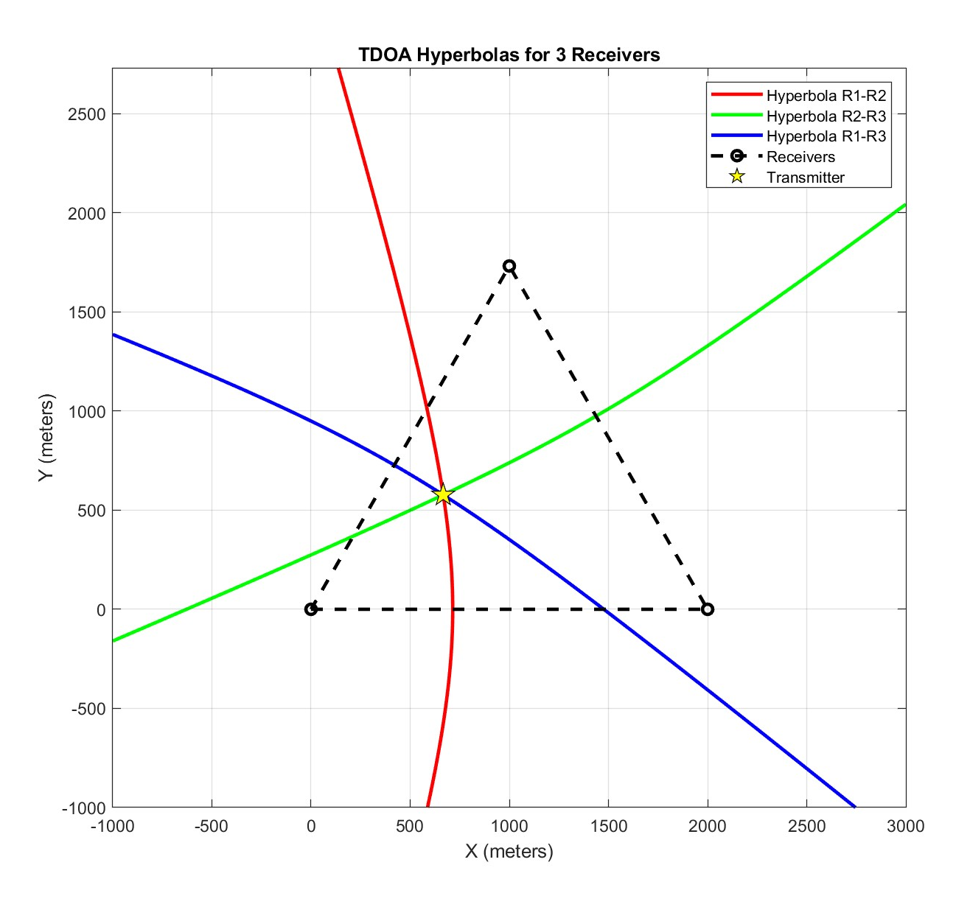
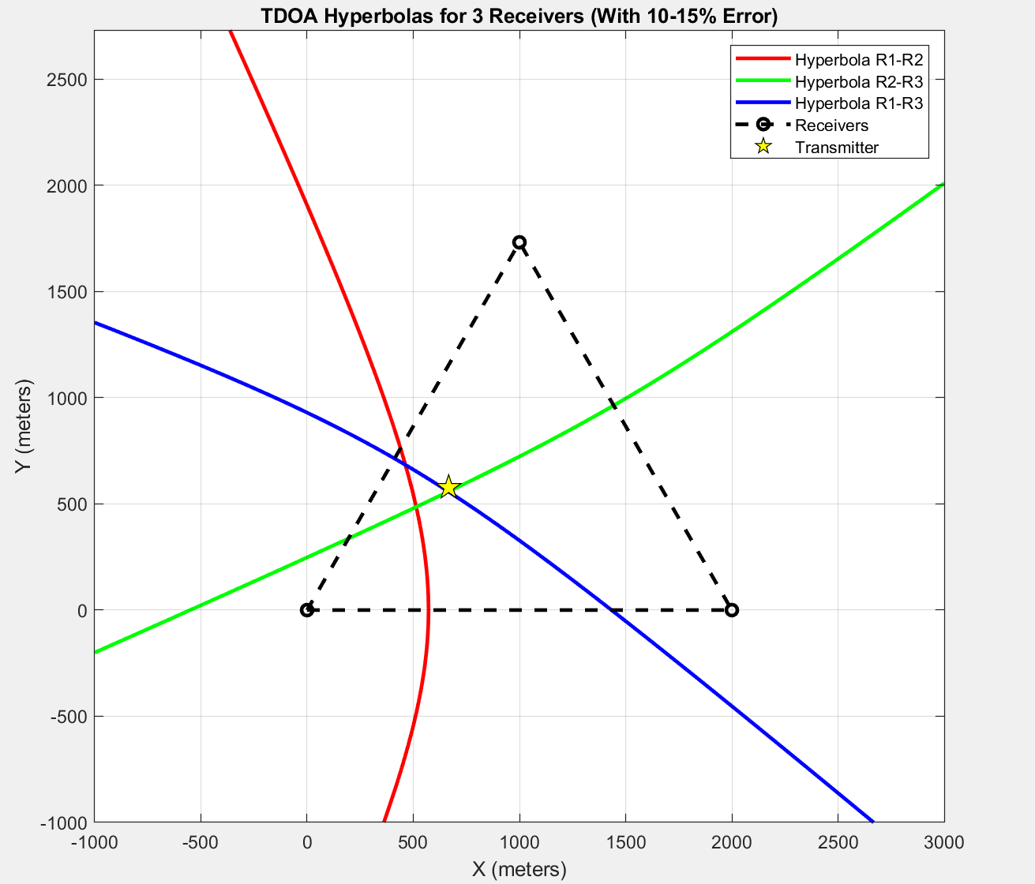
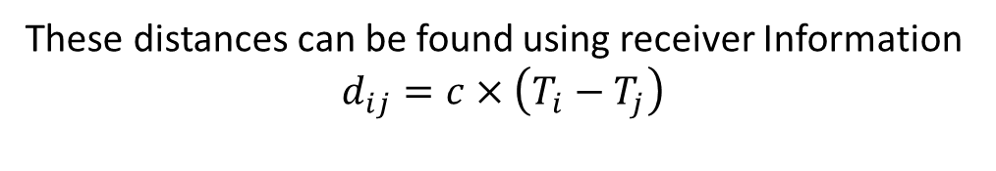
These distances can be found using receiver Information
$$d_{ij}=c×\left(T_{i}−T_{j}\right)$$
Time delay calculated via cross correlation of time signals received
by both receivers (signal processing part!)
In simulation we have assumed we know the receiver information and have calculated dij
Actual observation will look something like this
Ideal case (not practical)

Slide 5
To accurately determine the location of transmitter we can apply one of the following algorithms
Least Squares Estimation (LSE): The algorithm systematically searches for a coordinate point (x,y) that minimizes the sum of the squared distances to each of the hyperbolic lines of position
Chan-Ho Algorithm: A non-iterative algebraic method that transforms the non-linear TDOA equations into a linear system, which can be solved efficiently.
Taylor-Series Expansion: The non-linear equations are linearized around an initial position estimate. This simplified linear system is then solved, and the process is repeated with the new, more accurate estimate until the position converges

Slide 6
Objectives!
Learn basics of RTL-SDRs, HackRF one, GNU Radio Companion
Transmitter and receiver placement and circuit simulation
Synchronization among receivers
TDOA calculation and position estimation via visualization
Data handling and cross correlation

Slide 7
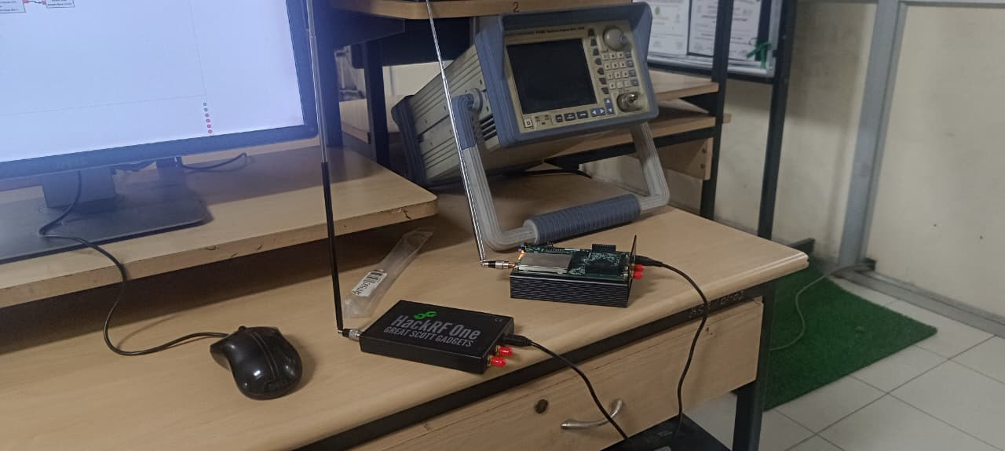
Learn Basics of RTL-SDRs, HackRF one, GNU Radio Companion
We started by creating a transmitter and receiver circuit, transmitted a WAV file using FM modulation
Tx
Rx

Slide 8
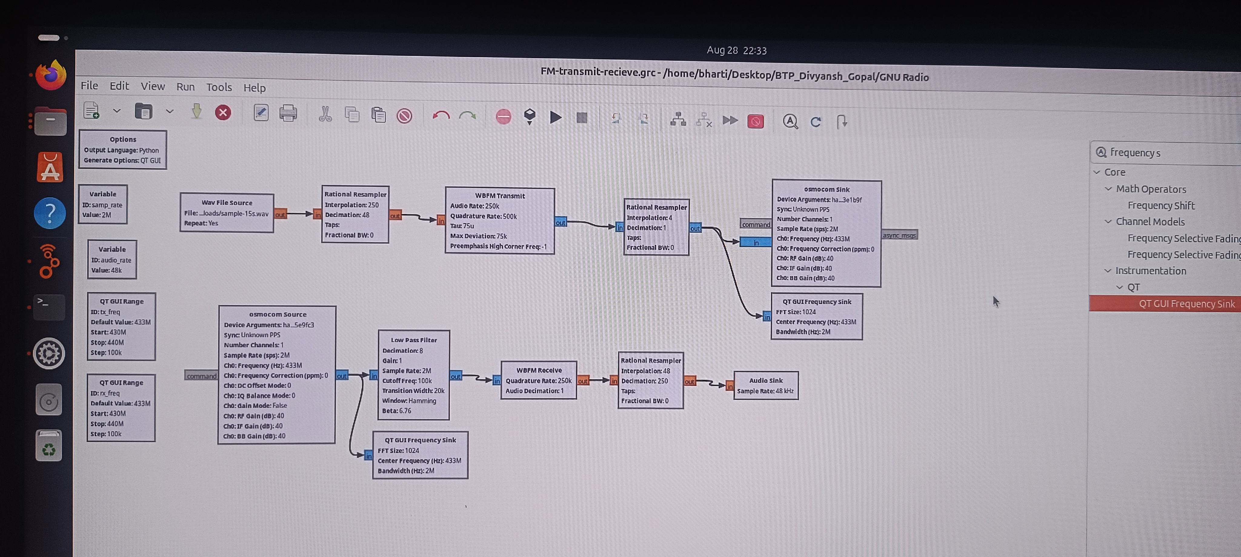
Flowgraph of this transmitter receiver circuit

Slide 9
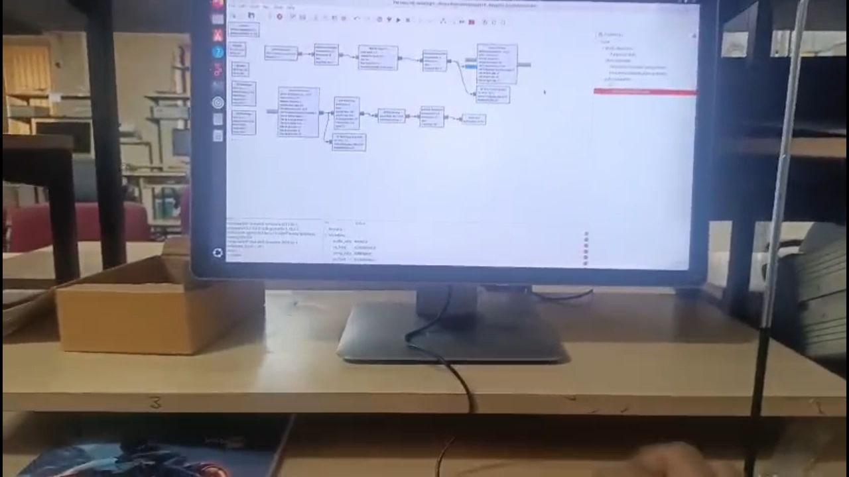
Demo

Slide 10
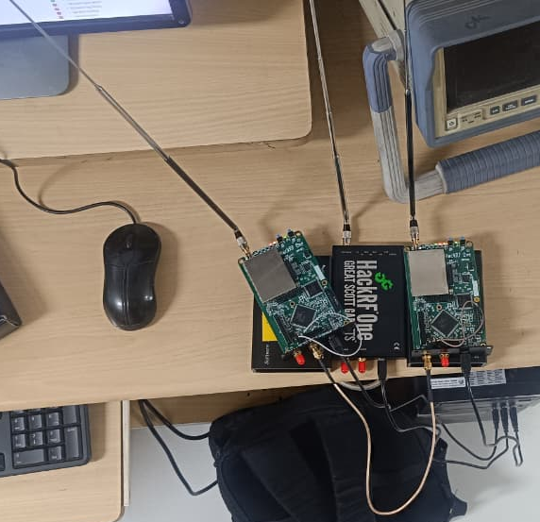
Transmitter and receiver placement and circuit simulation
Equipments used
3x HackRF one (2 Rx and 1 Tx)
1 SMA splitter cable
3x Antennas
For synchronization we used SMA cable to connect master CLOCKOUT of HackRF 1 to CLOCKIN of HackRF 2
Transmitter
Receiver 2
SMA cable
Receiver 1

Slide 11
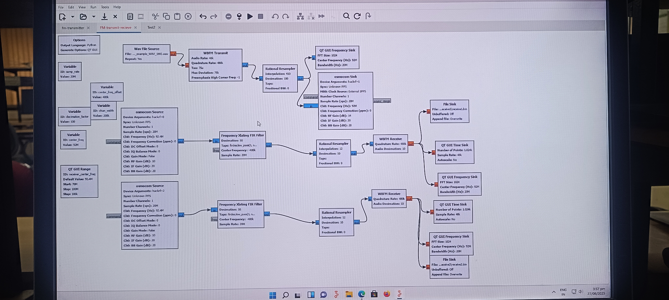
Flowgraph for 2 receiver and 1 transmitter circuit

Slide 12
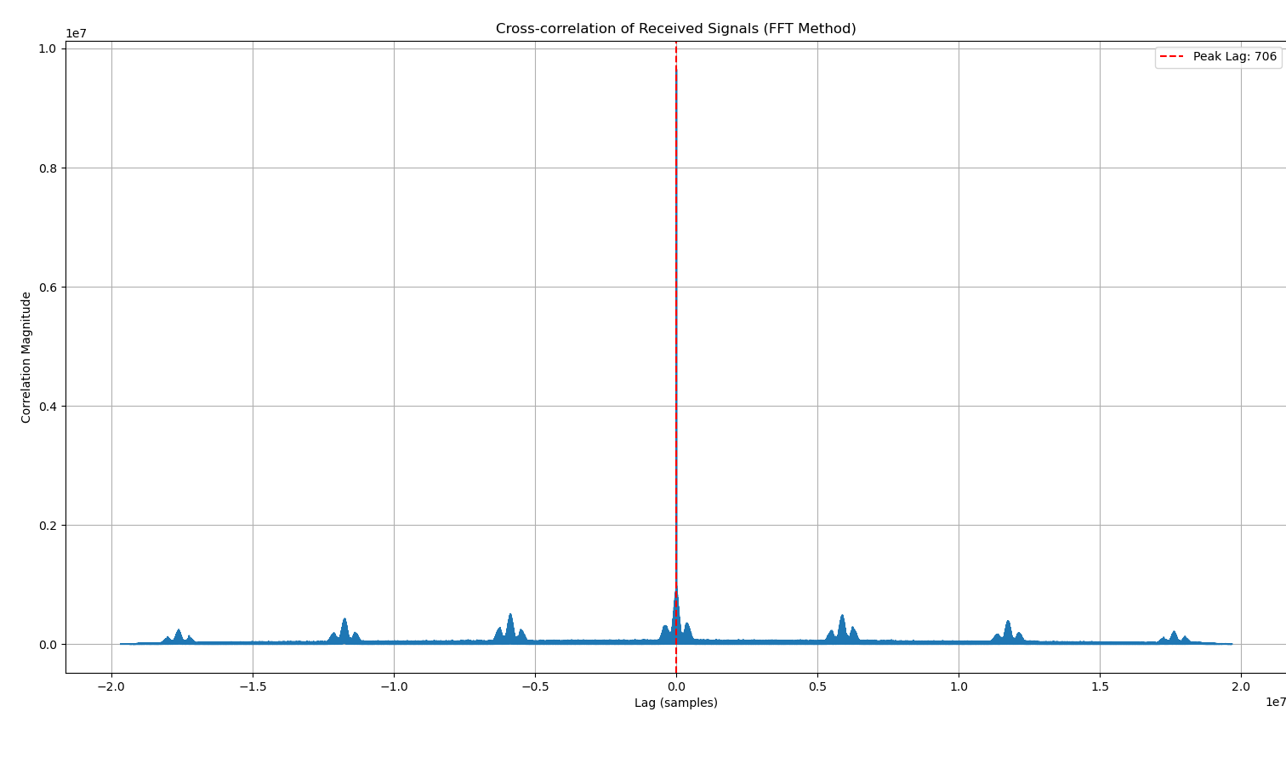
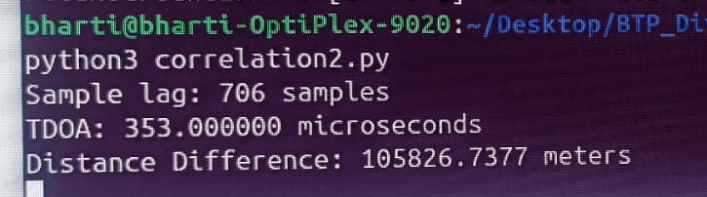
Result
Ran a Python Script that does cross correlation in the frequency domain using Fast Fourier Transform (FFT).
Cross- correlation Theorem – correlation in time domain is equivalent to a multiplication in the frequency domain
Our Script calculates time difference of arrival
Actual distance 0.2 meters From calculation we get 105,826 meters
Huge error!

Slide 13
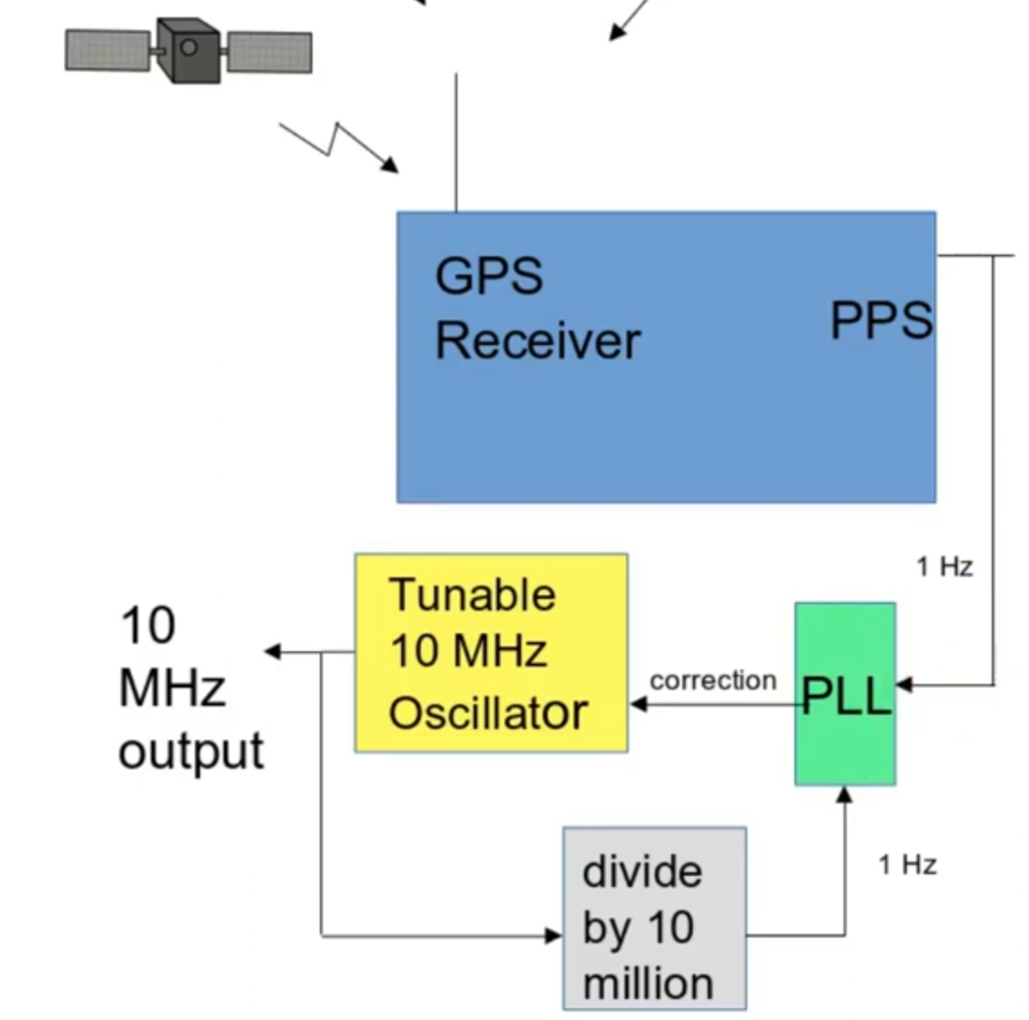
Synchronization, and optimal device placement
Clock in clock out method is not feasible as
Receivers need to be close
The SMA splitter cable induces phase delay
Achievable Resolution for delay measurement
10MHz sampling => 100ns . 3 . 1e8 = 30m
2GHz sampling => 0.5ns . 3 . 1e8 = 0.15m (good for lab experiment!)
This is the limiting factor for TDOA-based localization accuracy. Can't provide external clock in GHz as HackRF CLKIN only accepts 10 MHz signals (3.3V square wave).
Therefore we need to perform this at a bigger scale.
After searching online we found a solution, using GPS clocks!
GPSDO is the best option.
Provides <20ns synchronization accuracy between sites

Slide 14
Future Agenda
Achieve precise synchronization across all SDR (HackRF) receiver nodes using GPS Disciplined Oscillators as a frequency and timing reference
Determine possible sites of installation of our receiver setup across campus
Conduct a site survey using received GPS SNR, Wi-Fi heatmaps, and radio interference scans to identify clear line-of-sight positions
Set up Raspberry Pi 4 devices as local data acquisition and forwarding units for each receiver

Slide 15
References
Object Tracking Using Time Difference of Arrival (TDOA) - MATLAB & Simulink [1]
Software Defined Radio with HackRF, Lesson 1 - Great Scott Gadgets [2]
TDOA Transmitter Localization with RTL-SDRs - Panoradio SDR [3]
Combining two HackRF SDR to see more – Oleg Kutkov personal blog [4]
https://www.mdpi.com/1424-8220/18/11/4073/pdf?version=1542876960 [5]
https://www.mdpi.com/1424-8220/23/1/507/pdf?version=1672910374 [6]
https://ieeexplore.ieee.org/stamp/stamp.jsp?tp=&arnumber=7497354 [7]

Slide 16
Thank You

